Slide 1
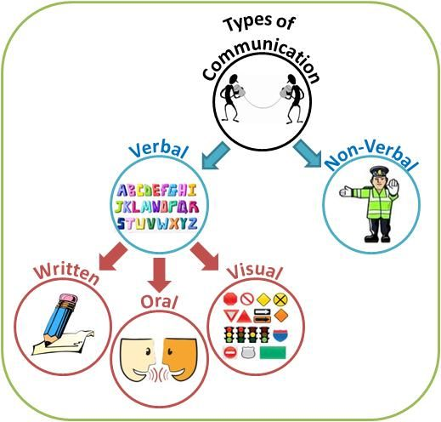
UNIT - II
TYPES OF COMMUNICATION

Slide 2

TOPICS TO BE COVERED
What is Communication
Types of Communication
Verbal & Non – Verbal Communication
Classification of Non- Verbal Communication
Barriers to Communication
Communicating Globally
Culture and Communication
Soft Skills
Interpersonal Communication
Listening
Persuasion
Negotiation
Communicating bad news/messages

Slide 3
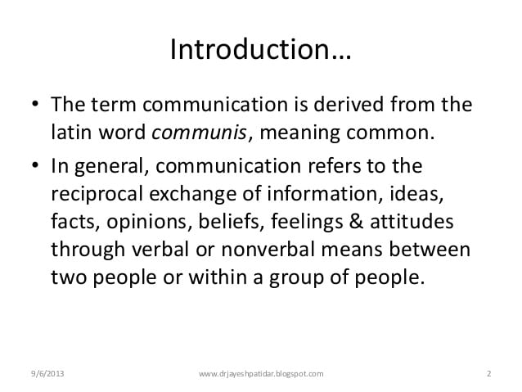
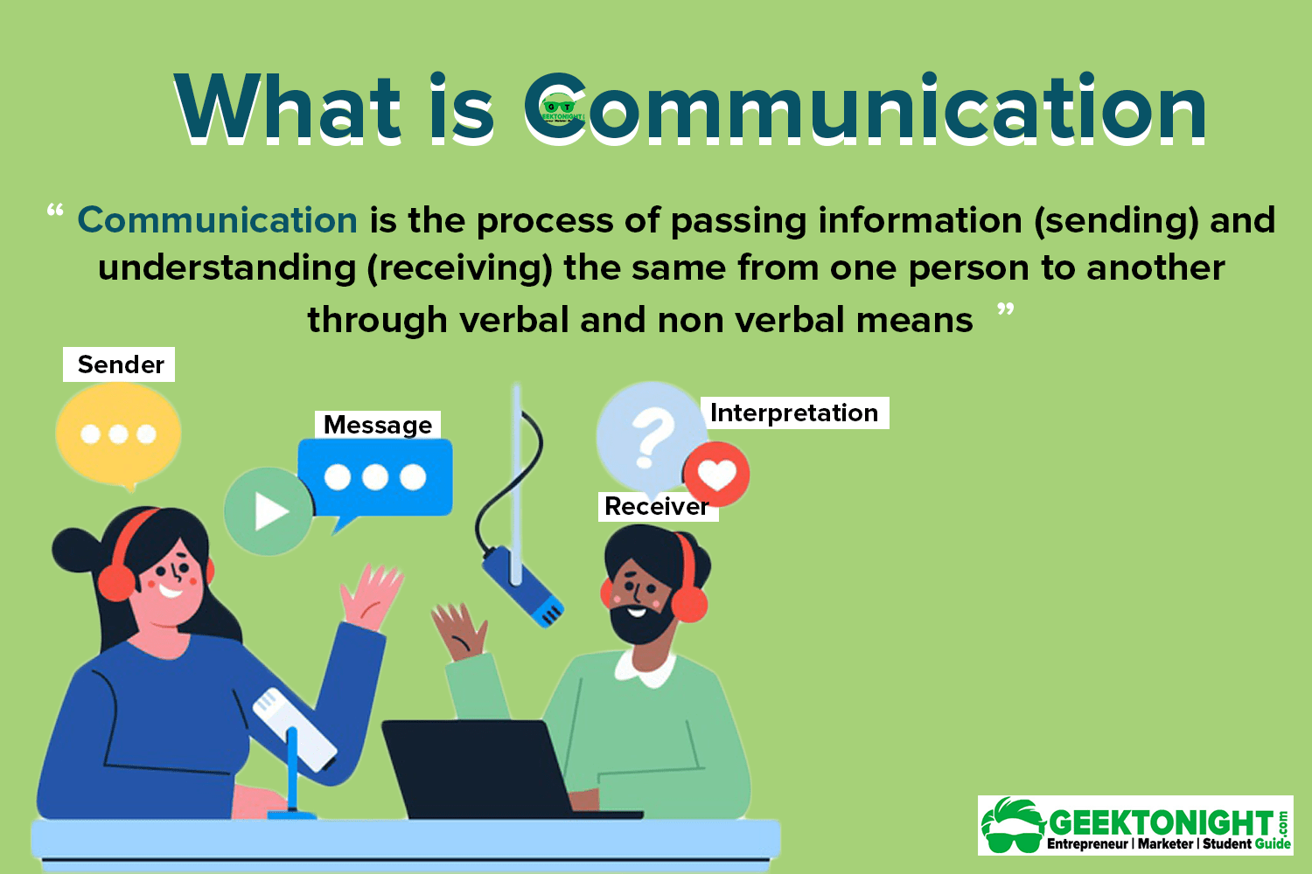

Slide 4
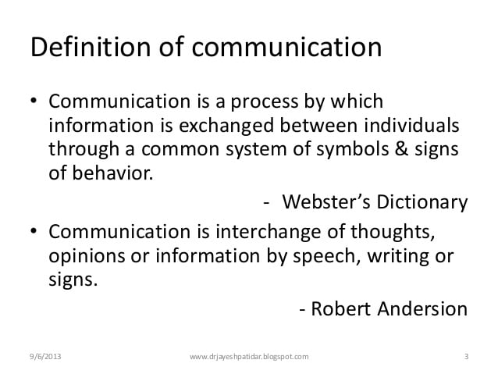


Slide 5
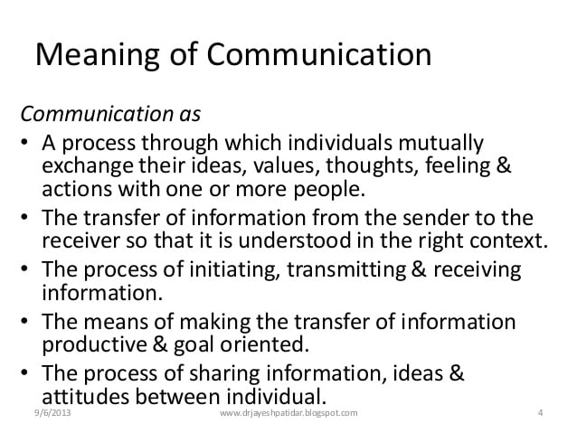

Slide 6
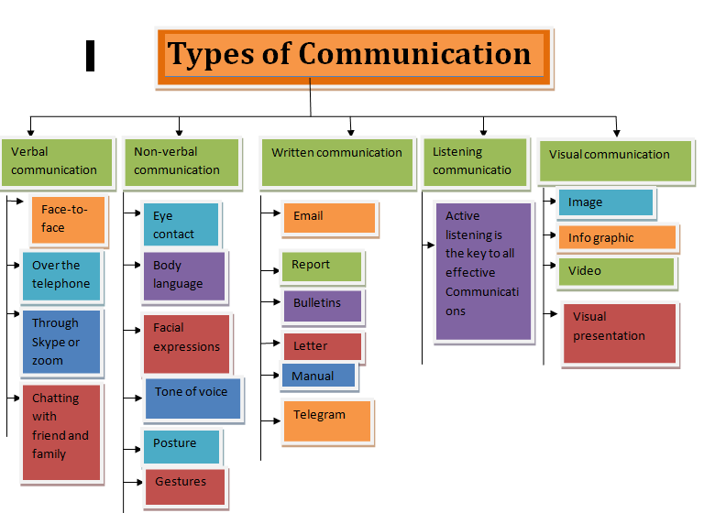

Slide 7
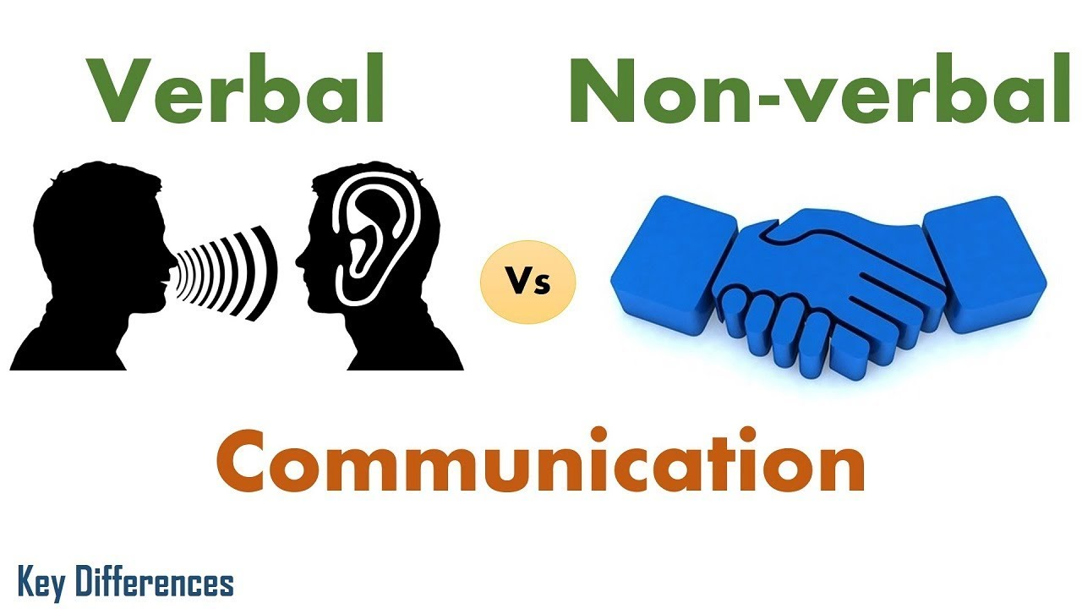
VERBAL AND NON- VERBAL COMMUNICATION

Slide 8

VERBAL COMMUNICATION
It means communicating with words, written or spoken. Verbal communication consists of speaking , listening , writing and reading.

Slide 9
CHARACTERISTICS OF EFFECTIVE VERBAL COMMUNICATION
Consider the Objective.
Be sincere.
Use simple language , familiar words.
Be brief and precise.
Assume nothing.
Use polite tone and words.
Say something pleasing and interesting.

Slide 10
MERITS
More personal and informal.
Makes immediate impact.
Provides opportunity for interaction and feedback.
It is fastest and less expensive.

Slide 11
DEMERITS
It can be quickly forgotten.
A word once uttered can not be taken back .
There is no legal evidence of oral communication .
Impact may be short lived.
Very difficult to be conscious of our body language.

Slide 12
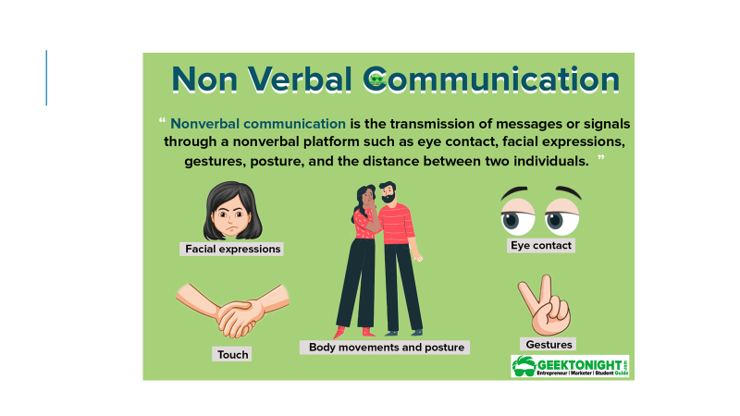
NON VERBAL COMMUNICATION
Non verbal communication includes all the unwritten and unspoken words or messages both intentional and unintentional.

Slide 13
FORMS OF NON VERBAL COMMUNICATION
Facial expression.
Body movement.
Gestures.
Eye contact.
Touch.

Slide 14
FEATURES
Nonverbal communication may be intentional or unintentional, since often when people communicate nonverbally, they are unaware of it.
Nonverbal communication is primary, because it takes precedence over verbal communication.
Nonverbal communication is continuous, because one is constantly communicating through nonverbal behaviors.
Nonverbal communication is often ambiguous, since a nonverbal behavior may have different meanings depending on the user’s personality, family influences, and culture.

Slide 15
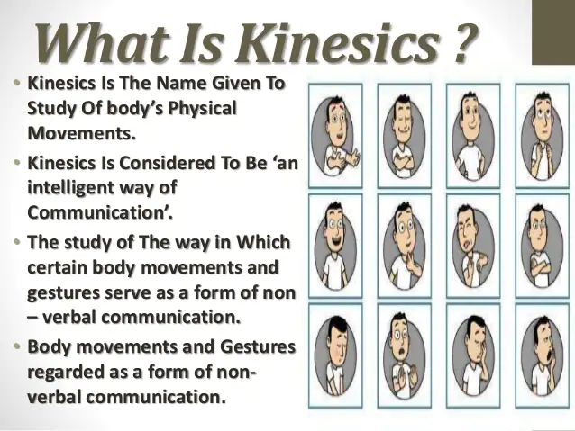

Slide 16
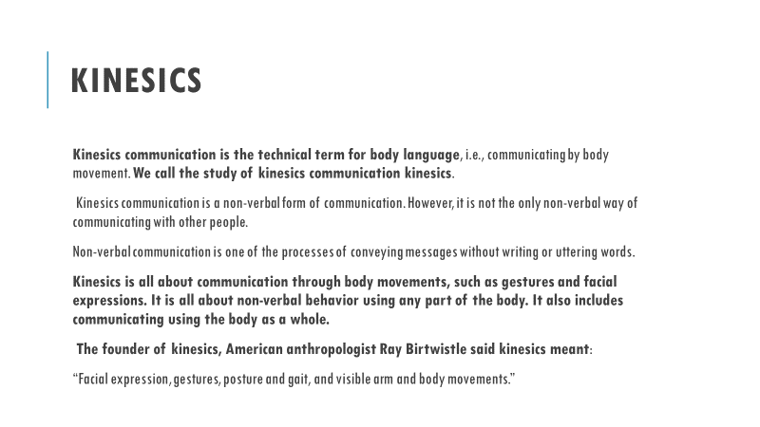

Slide 17
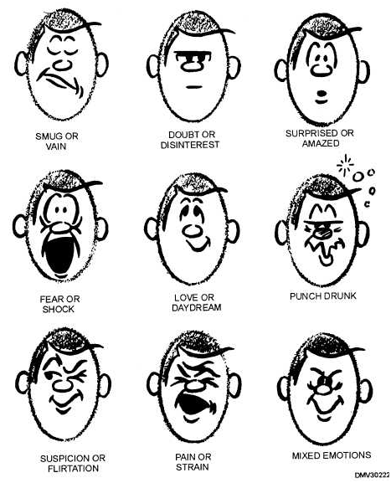
Facial expression
The face seems to be the most important component of body language, but it is the most confusing and difficult to understand.
A popular saying goes like this “ the face is the index of the heart.”
Whatever we feel deep within ourselves is at once reflected on the face.
Facial expressions are like sentence in human language, they are infinite in variety.

Slide 18
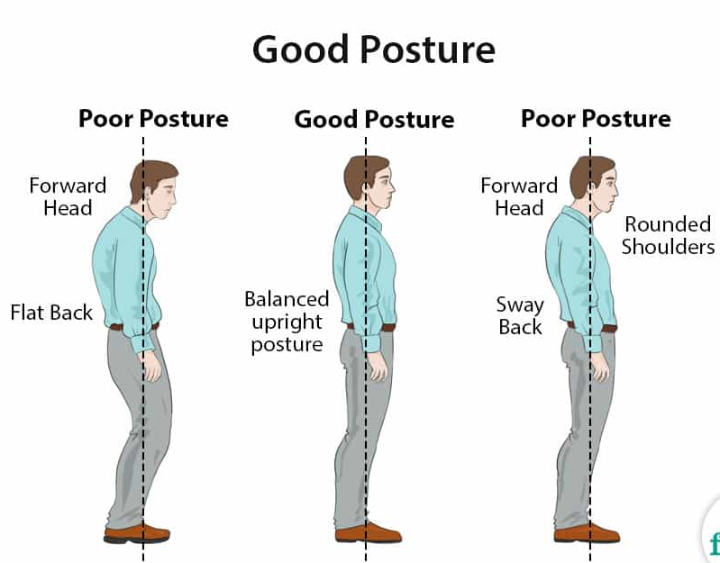
posture
The way you sit or stand can also communicate your comfort level, professionalism and general disposition towards a person or conversation. Example: Someone might slouch their shoulders if they feel tired, frustrated or disappointed.

Slide 19
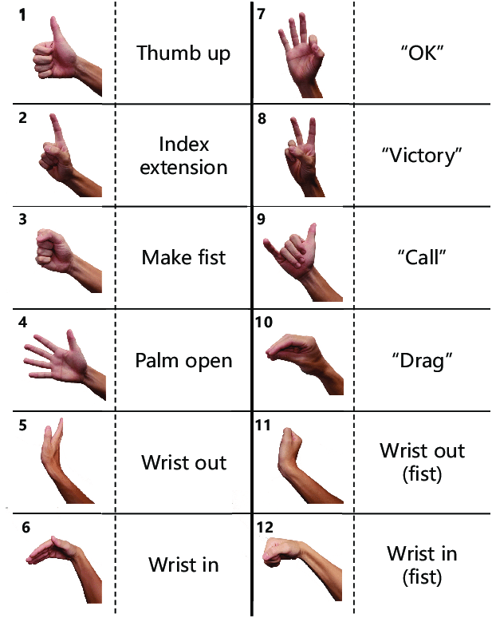
gesture
While gestures vary widely across communities, they are generally used both intentionally and unintentionally to convey information to others. Example: Someone in the United States might display a “thumbs up” to communicate confirmation or that they feel positively about something.

Slide 20
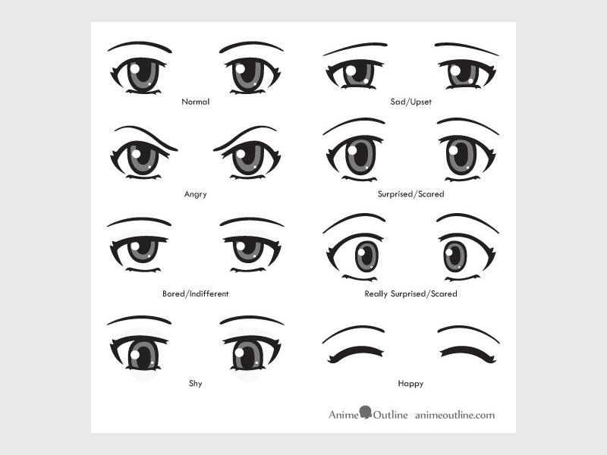
Oculesics
Oculesics is a form of nonverbal communication that derives meaning from eye behavior. It is a subcategory of kinesics — the study of body language — which decodes eye movement, gaze, eye behavior and everything your eyes may be conveying in a secret code.
Eye contact is a direct and powerful form of non- verbal communication. Eye contact have great importance in oral communication especially face to face contact
The direct stare of the sender of the message conveys candor and openness. It elicits the a feeling of trust.
Downward glazes are generally associated with modesty. Eyes rolled up is associated with fatigue. Eyebrows and eyelids raised and combined with dilated pupil tells us someone is excited.

Slide 21
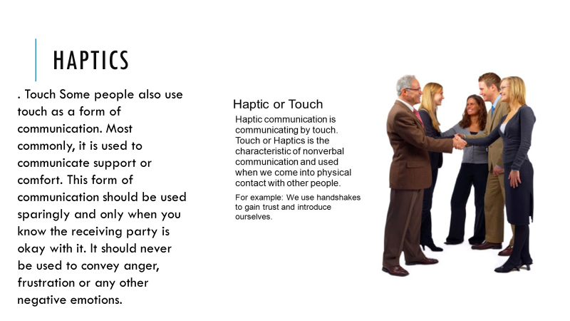

Slide 22
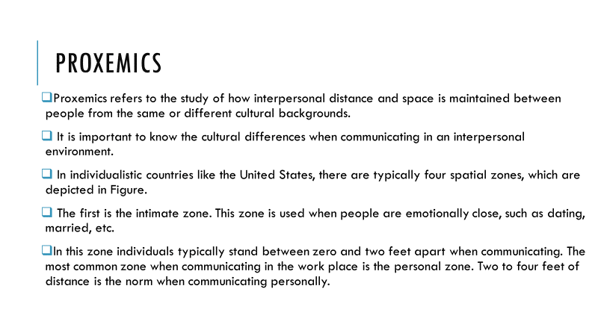
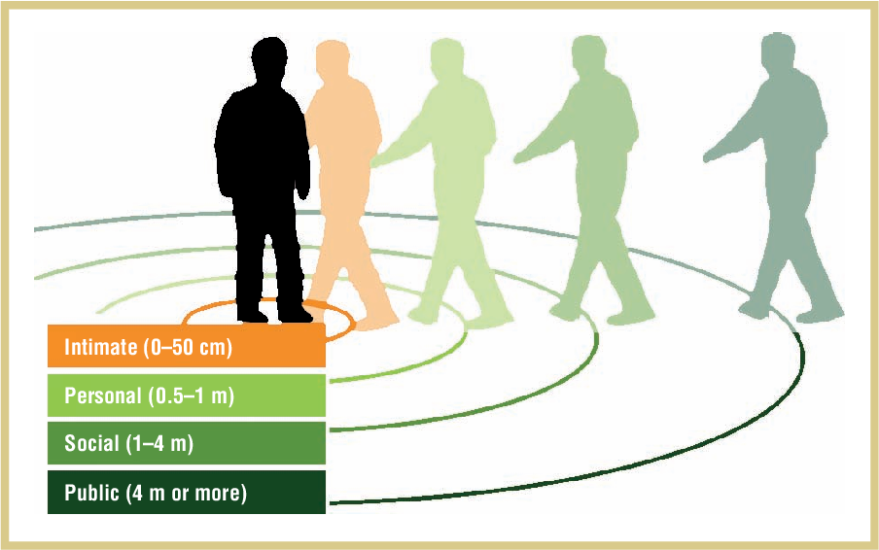

Slide 23
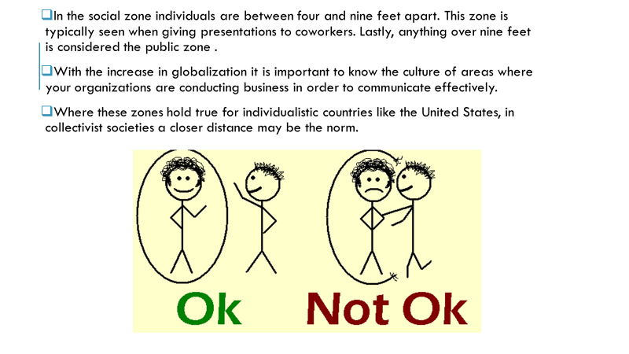

Slide 24
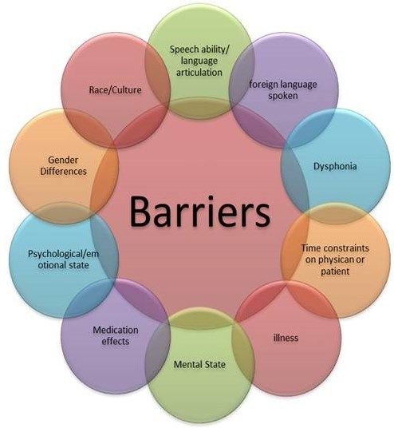

Slide 25
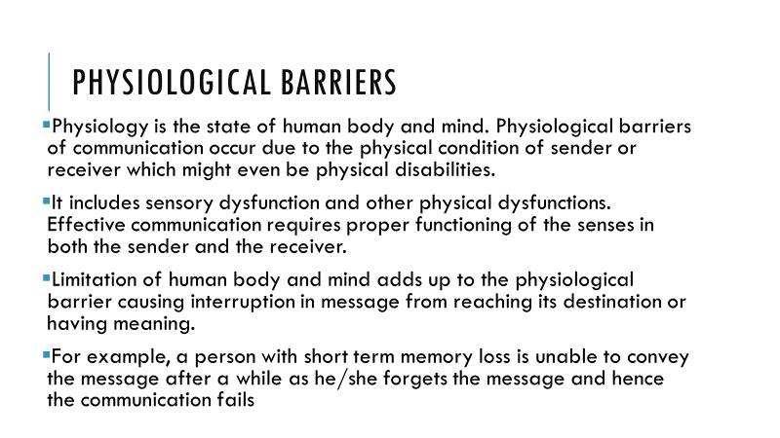
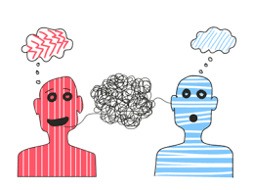
Physiological Barriers

Slide 26
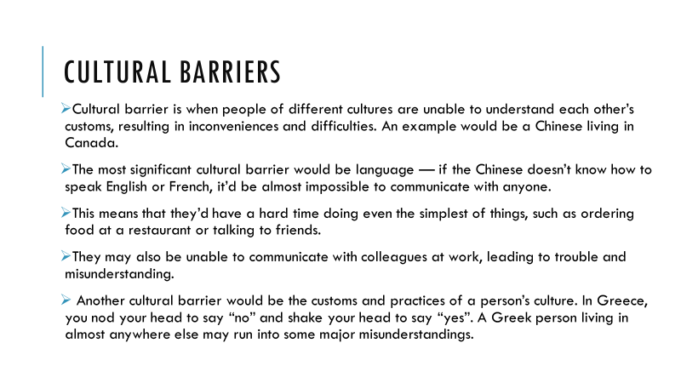

Cultural Barriers

Slide 27
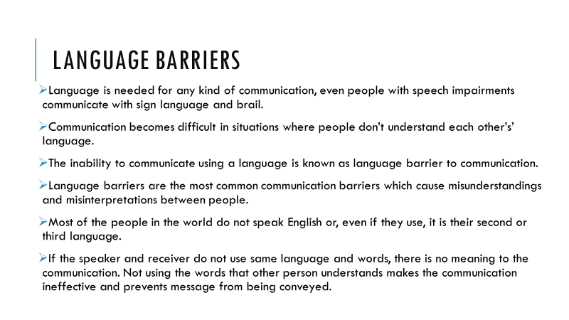

LANGUAGE BARRIERS

Slide 28
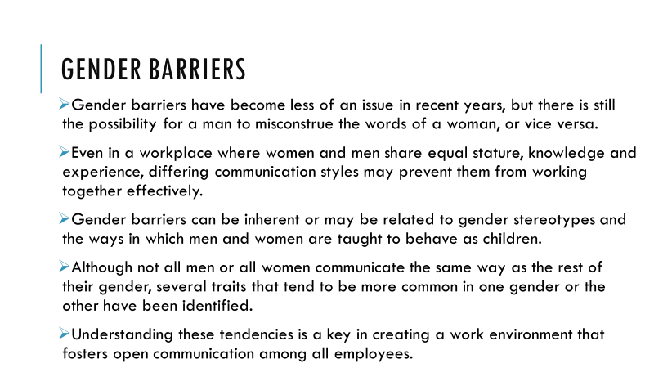
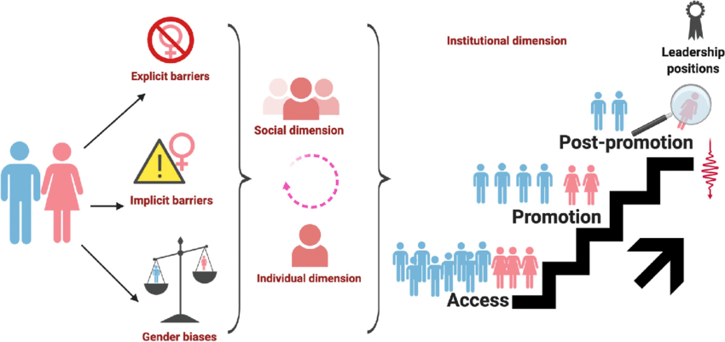
Gender Barriers

Slide 29
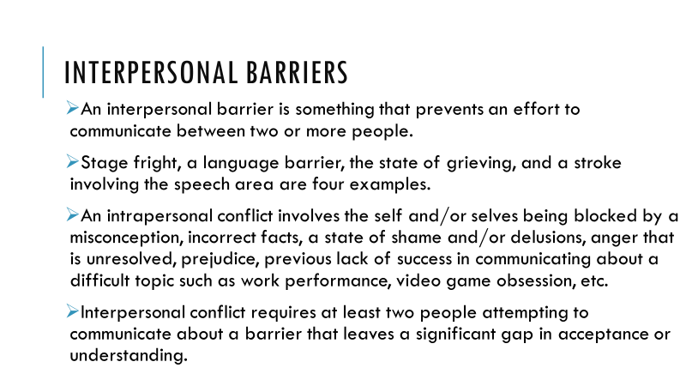

Interpersonal Barriers

Slide 30
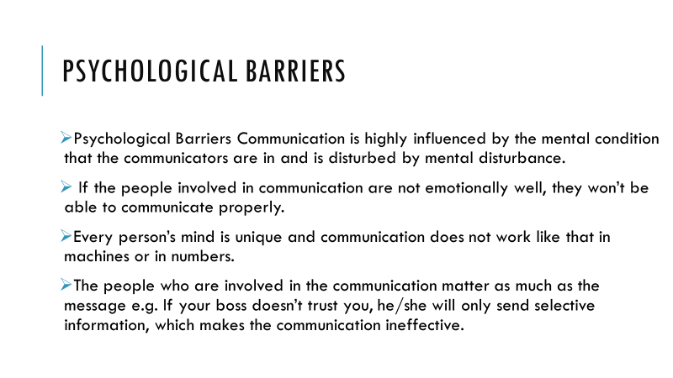


Slide 31

Emotional Barriers
Emotional barriers to communication are usually due to a lack of emotional awareness or control, often referred to as emotional intelligence. By better understanding our inner emotions, we can communicate more productively with others in the workplace and our everyday lives.

Slide 32


Slide 33
Global communication, can be defined just any communication can : a message is sent from one person or group to another anywhere in the world .
Communicating globally means the development and sharing of information , through verbal and non- verbal messages , in international settings and contexts.
One of the most common forms of global communication is an email.
When someone from another country reads your company's web page, this too is an example of global communication.

Slide 34
It is a broad field that incorporates multiple disciplines of communication, including intercultural, political, health, media, crisis, social advocacy, and integrated marketing communications.
Because of numerous technological advancements, the world has gotten smaller and communication is more effective and efficient.
Global communication is directly affected by the process of globalization, and helps to increase business opportunities, remove cultural barriers and develop a global village.

Slide 35
The Advantages of Global Communication
Makes the world a smaller place .
Increases business opportunities.
Improves cultural education .
It includes increased access to information.

Slide 36
DISADVANTAGES OF GLOBAL COMMUNICATION
Electronic access to valuable information , which can be used maliciously.
Social Disconnect.
No regulation and no quality control over available data.
Exposure to adult material or immoral things.
Increase in cyber crime through illegal activities , such as online gambling , selling drugs without license.

Slide 37
CULTURE AND COMMUNICATION
Communication is the process of exchanging information, and culture in communication refers to the effect of the cultural characteristics of communicators on this process.
A culture is the collection of shared characteristics of a group of people, and it’s comprised of habits, beliefs, and behavioral norms.
Culture plays a major role in your communication and in shaping style of communication.
While a person’s culture can make them naturally efficient at communication, it can also reduce their efficacy.

Slide 38
ADVANTAGES OF CULTURE AND COMMUNICATION
It helps you to identify the cultural basis of beliefs.
It helps you to identify cultural behaviors.
It improves your skill set for working with multinationals.
It makes you a better communicator.
It helps you to progress in your career.

Slide 39
WHAT CULTURAL ASPECTS AFFECT COMMUNICATION?
There are various aspects of cultures that affect how people exchange information, including:
Beliefs.
Habits.
Behavioral norms.
Freedom.
Clothing.
Technology.
Happiness

Slide 40
TIPS ON HANDLING CULTURE IN COMMUNICATION
Use the following tips to handle culture in communication effectively:
Use technology that suits the culture.
Develop strategies to deal with cultural differences.
Engage similar cultures.
Evaluate respect for your autonomy.
Work with progressive cultures.

Slide 41


Slide 42
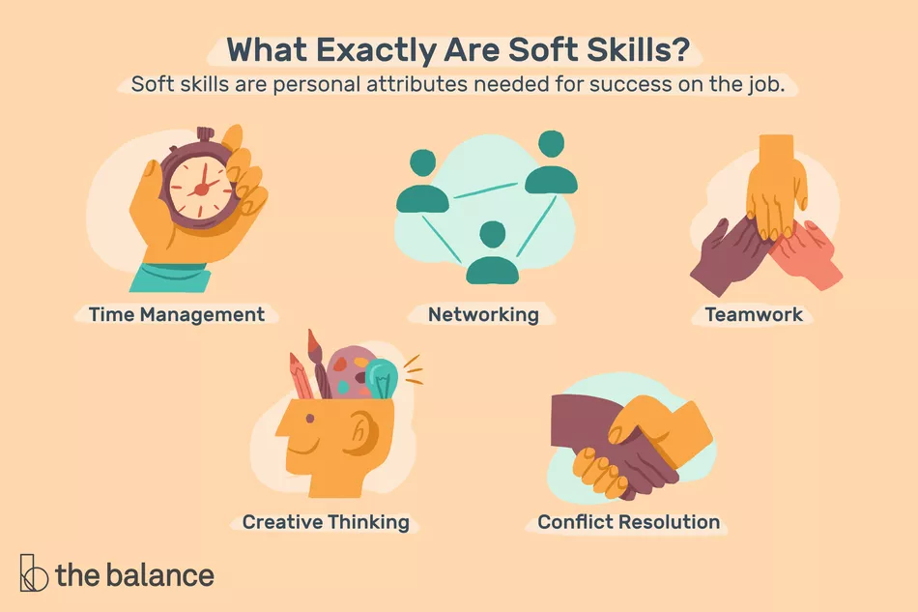

Slide 43
SOFT SKILLS
Soft skills are non-technical skills that relate to how you work.
Soft skills include interpersonal (people) skills, communication skills, listening skills , time management, and empathy, among others.
Soft skills are transferable skills that can be used regardless of the person's job. This makes job candidates with soft skills very adaptable employees.
Hiring managers typically look for job candidates with soft skills because they make someone more successful in the workplace .Someone can be excellent with technical, job-specific skills, but if they can't manage their time or work within a team, they may not be successful in the workplace.

Slide 44
TYPES OF SOFT SKILLS
Adaptability
Communication
Creative Thinking
Work Ethics
Teamwork
Time management
Motivation
Positivity
Problem- solving
Critical – thinking

Slide 45
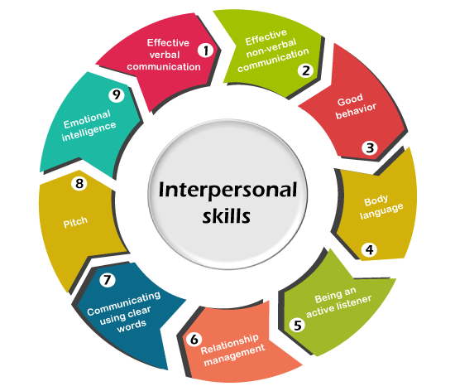

Slide 46
INTERPERSONAL SKILLS
Interpersonal skills are the behaviors and tactics a person uses to interact with others effectively.
Interpersonal skills help us interact with others effectively, on the job, and in the larger world.
Interpersonal skills are often referred to as social intelligence. They depend on reading the signals others send and interpreting them accurately in order to form a response.
In the business world, the term refers to an employee's ability to work well with others.
Interpersonal skills range from communication and listening to attitude and deportment.

Slide 47
WHY INTERPERSONAL SKILLS NEEDED
To Improve :
Relationship | Productivity
Working Environment | All Round Success
Leadership Skills | Liking by Others

Slide 48
WHEN & WHERE INTERPERSONAL SKILLS ARE REQUIRED AT WORKPLACE
While working in groups to form effective teams. | Listening & Questioning.
Socializing at workplace. | Giving or receiving feedback.
Presenting your self at work | Building & maintaining relationship.

Slide 49
HOW TO IMPROVE INTERPERSONAL SKILLS
Figure out what you need to improve.
Watch others.
Learn to control your emotions.
Reflect on your interactions.
Practice your skills.
Acknowledge others.
Avoid distractions.
Get a mentor.
Record yourself.

Slide 50
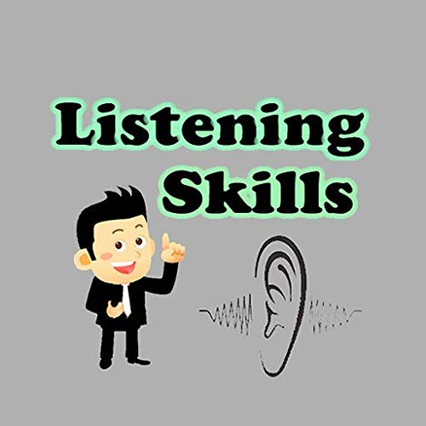

Slide 51
LISTENING
Listening is the ability to accurately receive and interpret messages in the communication process.
Listening is key to all effective communication.
Listening is a valuable technique that requires the listener to thoroughly absorb, understand, respond, and retain what’s being said.
Listening is one of the most important skills you can have.
An active process of getting information, ideas.
“Listening is the process of receiving, constructing meaning from, and responding to spoken.”

Slide 52
HOW TO LISTEN EFFECTIVELY
Stop talking – be silent.
Show interest.
Empathize .
Ask questions.
Maintain eye contact.
Take notes .
Listen carefully.
Put your entirety .
Send feedback .
Avoid or eliminate distraction.

Slide 53
BENEFITS OF EFFECTIVE LISTENING
Enhances productivity.
Improves relations.
Avoids conflicts.
Improves understanding.
Improves negotiation skills.
Adds to your Image & Personality.

Slide 54
PURPOSE OF LISTENING
To specifically focus on the messages being communicated, avoiding distractions and preconceptions.
To gain a full and accurate understanding into the speakers point of views and ideas.
To show interest , concern and concentration.
To encourage the speaker to communicate fully , openly , and honestly.
To develop a selflessness approach , putting the speaker first.
To arrive at a shared and agreed understanding and acceptance of both sides views.

Slide 55
HOW TO IMPROVE YOUR LISTENING SKILLS
Limit interruptions
Pay attention to what’s being said, not what you want to say.
Be okay with silence.
Encourage the other person to offer ideas and solutions before you give yours
Restate the key points you heard and ask whether they’re accurate.

Slide 56
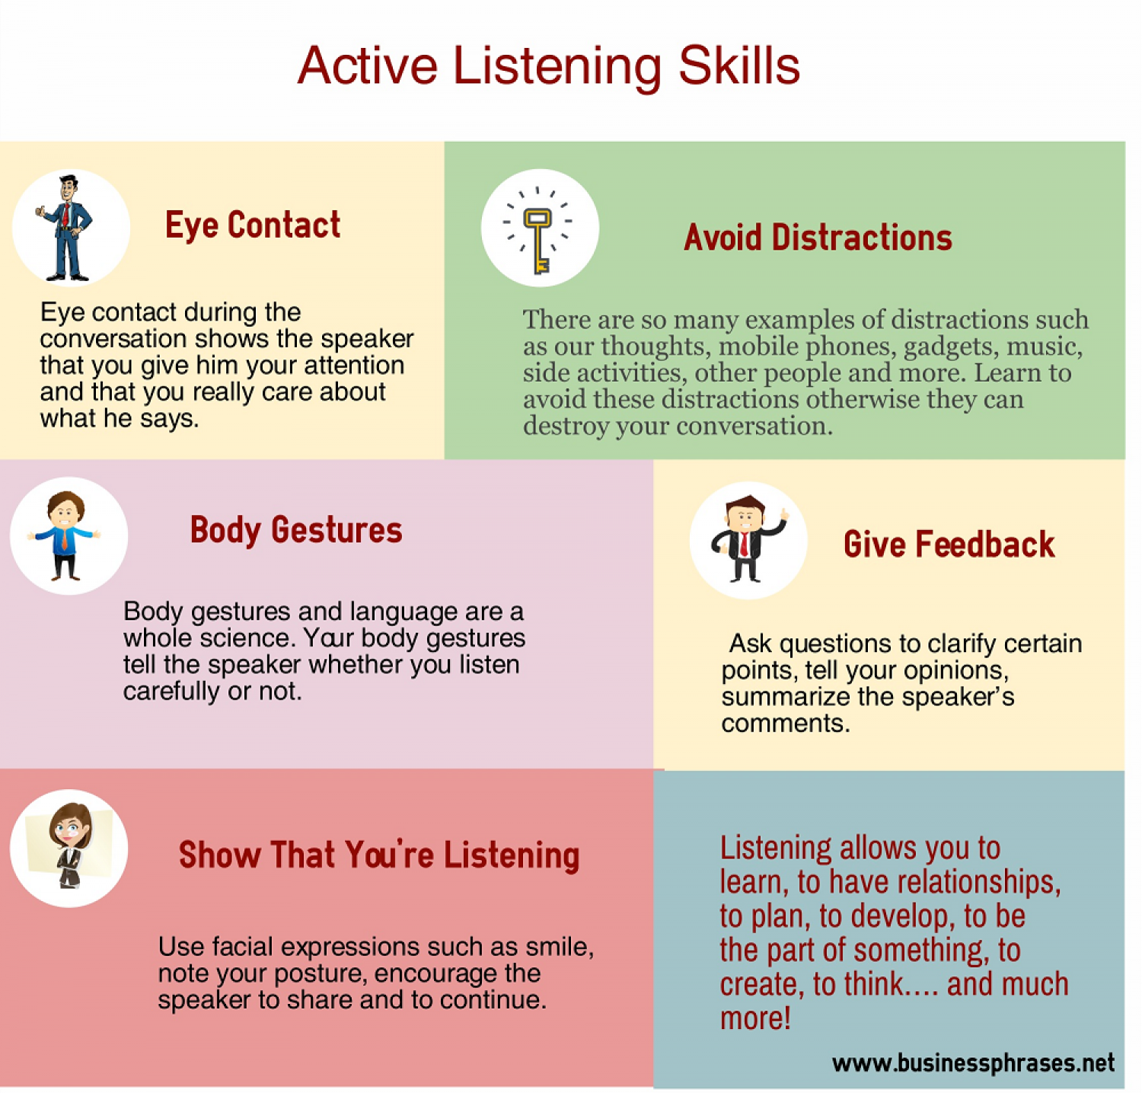

Slide 57
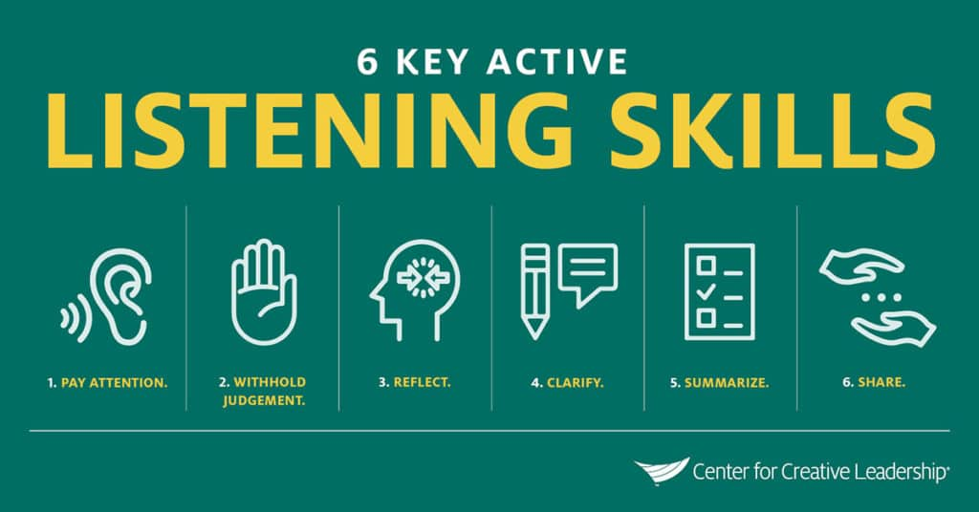

Slide 58
BARRIERS TO EFFECTIVE LISTENING
Pre-judgments about the speaker.
Assuming that the speaker is going to give some unimportant information .
Arriving late for a speech, presentation or lecture
Lack of concentration/interest .
Speaker or listener being distracted by disturbances .

Slide 59
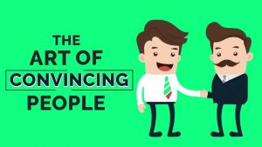
PERSUASION

Slide 60
Persuasion is convincing others to agree with your point of view or follow a course of action.
Persuasion involves assessing your audience's needs, building rapport, focusing on the benefits, countering objections, and finding common ground.
Persuasion is a skill that can be learned and improved.
Employers value persuasive skills in employees because these skills can impact many aspects of job performance
Persuasion is an innate personality trait in some, but it's also a skill that can be learned and improved.
Sales is the most obvious form of persuasion, but this skill is used in many other positions as well.

Slide 61
KEY ELEMENTS IN PERSUASION
The Source : The person who sends communication.
The Receiver : The target of a persuasive message.
The Message : The content of a piece of communication.
The Channel : The medium used to send the communication.
Eg. Newspaper , television, the Internet , verbal & non verbal communication.

Slide 62
TIPS TO SUCCESSFUL PERSUASION
Focus on the needs of other party.
Argue your case with logic.
Use positive rather than negative language.
Subtly compliment the other party.
Mirroring the other person’s

Slide 63


Slide 64
NEGOTIATION
A negotiation is a strategic discussion that resolves an issue in a way that both parties find acceptable.
By negotiating, all involved parties try to avoid arguing but agree to reach some form of compromise.
Negotiations involve some give and take, which means one party will always come out on top of the negotiation.
When negotiating, be sure to justify your position.
Before you begin the negotiating process, it's a good idea to know when you'll walk away.

Slide 65
HOW TO NEGOTIATE EFFECTIVELY
React sensibly.
Patience .
Confident .
Be dignified .
Be very clear in your communication.
Be a good listener .
Be reasonable

Slide 66
TIPS TO IMPROVE NEGOTIATION SKILLS
Prepare for the negotiation.
Be ready to compromise.
Set a timeline.
Offer multiple solutions.
Speak with confidence.
Learn to accept failures.
Work on your weakness.
Practice negotiation.

Slide 67
CHALLENGES FOR AN EFFECTIVE NEGOTIATION
Lack of time.
Going unprepared for a negotiation.
Lack of patience.
Criticism, sarcasm, derogatory remarks .
Avoid last minute changes .
Being too rigid.
Lack of confidence.

Slide 68


Slide 69
COMMUNICATING BAD NEWS/MESSAGES
Delivering bad news is something that we all have to do at some point.
Bad news is always difficult to handle, whether you’re delivering it or receiving it.
Financial hardship, closedowns, restructures and layoffs are commonplace.
Delivering bad news effectively is essential for maintaining morale, ensuring business competitiveness and protecting the brand.
Delivering bad news is tough. It’s even harder when you don’t agree with the message or decision you’re communicating.

Slide 70
“In a managerial role, it’s natural to feel ambivalence” when delivering disappointing news.”
“As a manager, you walk a fine line between being a company advocate and an employee advocate.”
Reconciling the two is no easy task and you often feel stuck between a rock and a hard place. Here’s how to navigate the situation:
Prepare for the conversation.
Be direct and avoid mixed messages.
Explain how the decision was made.
Allow for venting, not debate.
Focus on the future.
Putting it all together.

Slide 71
DO’s OF COMMUNICATING BAD NEWS/MESSAGES
Prepare yourself.
Give the employees the opportunity to speak their mind.
Make an effort to be encouraging.
Treat them with empathy.
Anticipate people’s questions.

Slide 72
DON’Ts OF COMMUNICATING BAD NEWS/MESSAGES
Don't joke around.
Don't beat around the bush.
Don't be too vague.
Don't give advice unless asked.
Don’t sugar coat too much.

Slide 73


